Slide 1
Jean Monnet Chair Small Area Methods for Monitoring of Poverty and Living conditions in EU (SAMPL-EU)
Lecture 7: Sample weighting
http://sampleu.ec.unipi.it

Slide 2
Example: estimation for domains
Happy Land Food Survey
Stratified two stage sample survey
H=5 strata; N=20000 households
A= 200 villages in HL (clusters)
a=50 sampled villages
n=500 households
Complete coverage of the target population
Full response of the interviewed households

Slide 3
Target Population
(households in HL)
Divided into 4 Zones
Northern HL
Western HL
Central
HL
Eastern
HL
Southern HL
50 villages
50 villages
50 villages
50 villages
50 villages
Every village:200 households
Every village:200 households
Every village:200 households
Every village:200 households
Every village:200 households

Slide 4
Sample design and selection
(ultimate sampling units households in HL)
Divided into 4 Strata
stratification
Northern HL
Central HL
Eastern HL
Western HL
Southern HL
1st STAGE selection
Srs of 10 clusters out of
50 clusters
Srs of 13 clusters out of 50 clusters
Srs of 6 clusters out of 50 clusters
Srs of 7 clusters out of 50 clusters
Srs of 14 clusters out of 50 clusters
2nd STAGE selection
Srs of 10 hhs out of 200 hhs
Srs of 10 hhs out of 200 hhs
Srs of 10 hhs out of 200 hhs
Srs of 10 hhs out of 200 hhs
Srs of 10 hhs out of 200 hhs

Slide 5
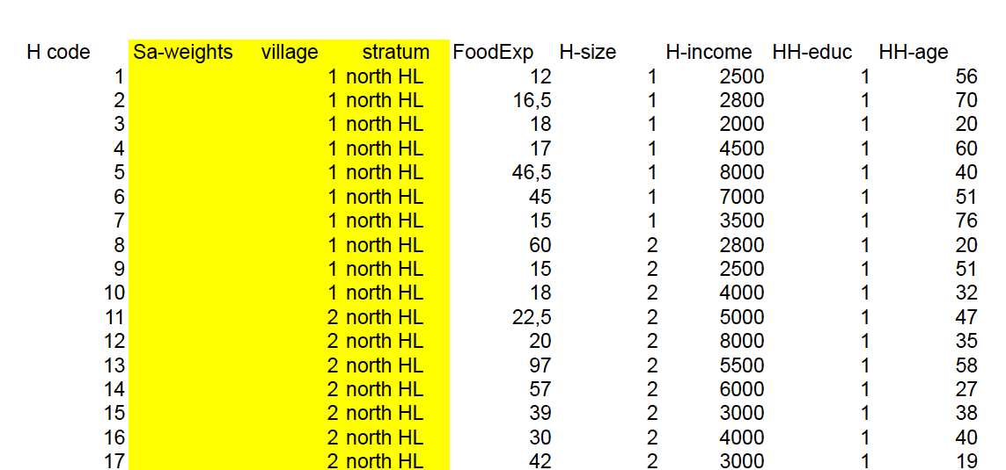

Slide 6
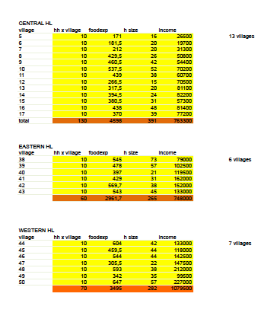

Slide 7
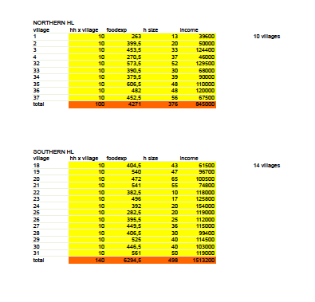

Slide 8
Probability of inclusion of k-th hh
This is what I need: 1/π_{k}=a_{k}
Sampling weight for the k-th household
π_{k}= π_{hi} x π_{hk|i}
π_{hi}
probability of inclusion of the village (h-th stratum)
π_{hk|i}
probability of inclusion of the household, given that the i-th village is included (h-th stratum)

Slide 9
# Package "laeken"
# Package "laeken"
# Estimation of Laeken indicators using synthetic EU-SILC data
# description of the EU-SILC survey:
# http://ec.europa.eu/eurostat/web/microdata/european-union-statistics-on-income-and-living-conditions
# load the library (necessary to install it in R the first time it is used)
library(laeken)
# load synthetic Austrian EU-SILC data
data(eusilc)
dim(eusilc)

Slide 10
# Package "laeken"
# A data frame with 14827 observations on the following 28 variables:
# db030 integer; the household ID.
# hsize integer; the number of persons in the household.
# db040 factor; the federal state in which the household is located (levels Burgenland, Carinthia, Lower Austria, Salzburg, Styria, Tyrol, Upper Austria, Vienna and Vorarlberg).
# rb030 integer; the personal ID.
.
.
.
# db090 numeric; the household sample weights.
# rb050 numeric; the personal sample weights.

Slide 11
# Package "laeken"
# AT-RISK-OF-POVERTY RATE
# at-risk-of-poverty rate: national level
arpr(eusilc$eqIncome, weights = eusilc$rb050, design =eusicl$db040)
# at-risk-of-poverty rate: federal states level (NUTS 2)
arpr(eusilc$eqIncome, weights = eusilc$rb050, design =eusilc$db040, breakdown = eusilc$db040)
Federal state indicator

Slide 12
# Package "laeken"
# computing confidence intervals: national level
a <- arpr(eusilc$eqIncome, weights = eusilc$rb050, design =eusicl$db040)
bootVar(inc=eusilc$eqIncome, weights = eusilc$rb050, design =eusilc$db040, indicator=a, R=1000, bootType="naive", ciType="perc")
# computing confidence intervals: federal states level (NUTS 2)
a.states <- arpr(eusilc$eqIncome, weights = eusilc$rb050, design=eusilc$db040, breakdown=eusilc$db040)
bootVar(inc=eusilc$eqIncome, weights = eusilc$rb050, design =eusilc$db040, indicator=a.states, breakdown=eusilc$db040, R=1000, bootType="naive", ciType="perc")

Slide 13
“Statistically sound estimate” 1
In descriptive statistics: the coefficient of variation (CV) is the ratio of the standard deviation to the value of the mean
Coefficient of Variation = (Standard Deviation/ mean) * 100.
For example, the expression “The standard deviation is 15% of the mean” is a coefficient of variation.

Slide 14
“Statistically sound estimate” 2
In descriptive statistics:
the CV is particularly useful when you want to compare variability of two different groups or populations.
For example: Income in Pop A has CV=15%, Income in Pop B has CV=30%...the distribution of income in Pop B has more dispersion (is more variable)

Slide 15
“Statistically sound estimate” 3
In Statistical Inference: the coefficient of variation (CV) is the ratio of the standard error of an estimate to the value of the estimate
Coefficient of Variation = (Standard Error / Estimate) * 100.
For example, the expression “The standard error is 15% of the estimate” is a coefficient of variation.

Slide 16
“Statistically sound estimate” 3
In Statistical Inference:
For example: estimator A has CV=15%, estimator B has CV=30%...the sampling distribution of estimator B has more dispersion (is more variable) and the estimator B is less efficient than A

Slide 17
“Statistically sound estimate” 4
In sample survey (Inference)
The CV is particularly useful when you want to assess the accuracy (efficiency + unbiasdeness) of the results of a survey (estimate):
The MSE (Mean Squared Error) is equal to Variance + Bias^2
MSE(estimator) = Variance(estimator)+bias(estimator)^2
Coefficient of Variation = square root(MSE(estimate)) /(Estimate) * 100.
For example, the expression “The sqrt(MSE) is 15% of the estimate” is a coefficient of variation and it is a measure of the accuracy of the estimate

Slide 18
“Statistically sound estimate” 5
It means accurate, with a low CV.
When I say low it means that its value should not exceed the 20-30% of the value of the estimate itself.
Many Official Statistical Agencies do not publish estimates with CV higher than 20%

