Slide 1
Jean Monnet Chair Small Area Methods for Monitoring of Poverty and Living conditions in EU (SAMPL-EU)
Lecture 0: Learning outcomes
http://sampleu.ec.unipi.it

Slide 2
Definition of Poverty
...and Living Conditions

Slide 3
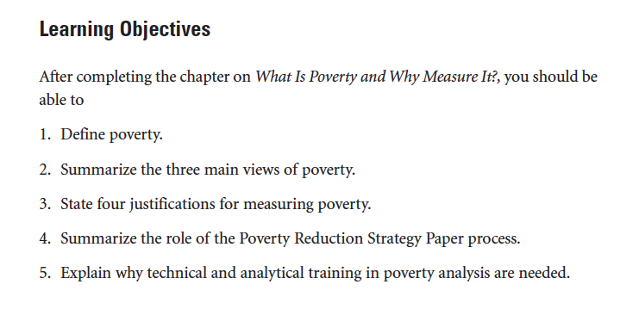

Slide 4
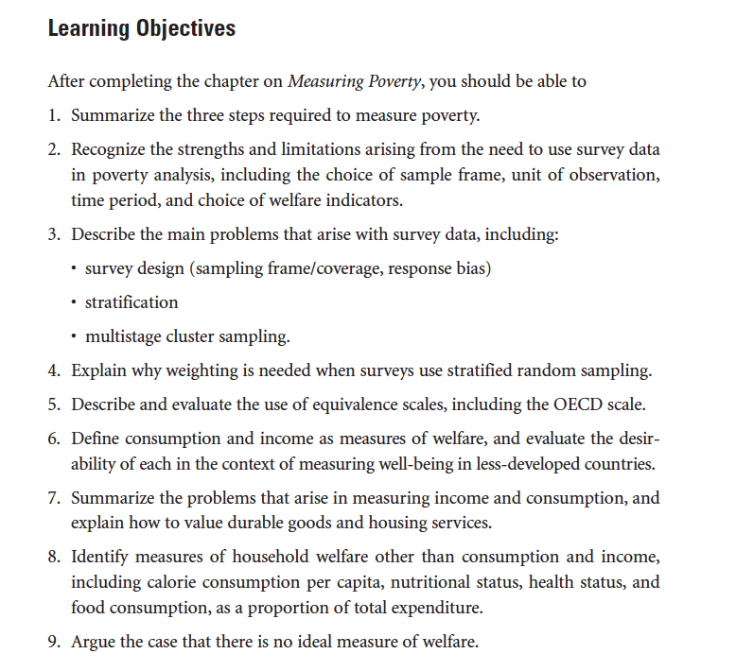

Slide 5
