Slide 1
Big Data and Nowcasting
Table 3 New and traditional data sources for local indicators –
is it possible reconciling small areas and big data?
Dario Buono*, European Commission, Eurostat
dario.buono@ec.europa.eu @darbuono
*The views expressed are the author’s alone and do not necessarily correspond to those of the corresponding organisations of affiliation
Workshop on Small Area Methods and living conditions indicators in European poverty studies in the era of data deluge and Big Data
Pisa, 8-10 May 2018

Slide 2
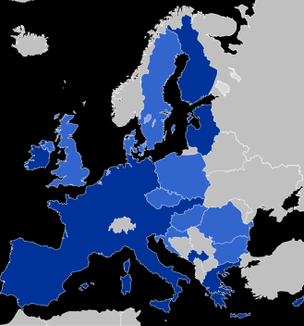
Eurostat, the Statistical Office of EU
About 700 people with 28 different nationalities
Statistical Office of European Union, part of EC
Core business:
Euro-zone (19) & EU (28) aggregates
harmonization, best practices, guidelines, trainings & international cooperation, grants research funds
Methodology team: Time Series, Econometrics, Data Analytics, Use of R in Statistical Offices

Slide 3
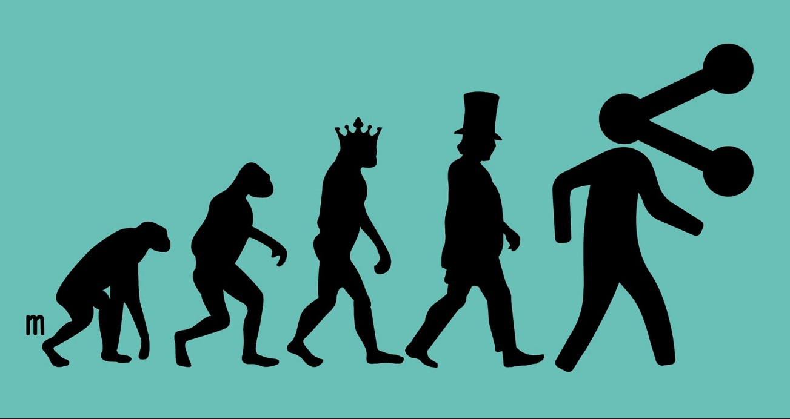
Digital (r) Evolution?

Slide 4
State-of-play
Explosion of information around us
Popularity of internet and other new technologies
Multitude of new data sources
Is change needed?
Do not start with data, but start with a good question!

Slide 5
Why interested in Big Data for nowcasting?
Big Data are complementary information to standard data, being based on different information sets
More granular perspective on the indicator of interest, both in the temporal and cross-sectional dimensions
It is timely available, generally not subject to revisions

Slide 6
A Big Data expert is… actually a team!

Slide 7
….ended in these research activities
Can Big Data help for Macroeconomic Nowcasting?
What are the potential Big Data sources?
Literature review
Models/methods to be used for Big data
Recommendations on how to handle Big Data
Case study: IPI, Inflation, unemployment of some EU countries

Slide 8
Big Data types & dimensionality
When the dimensionality increases, the volume of the space increases so fast that the available data become sparse.
Use of a typology based on Doornik and Hendry (2015):
Tall data: many observation, few variables
Fat data: many variables, few observations
Huge data: many variables, many observations

Slide 10
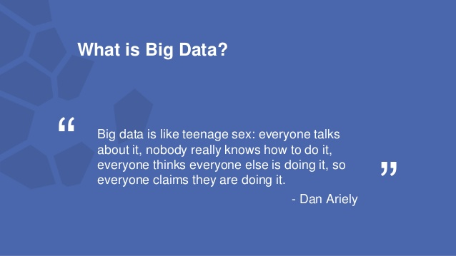

Slide 11
Big Data Types potentially interesting for Macro Nowcasting
Financial markets data | Scanner prices data
Electronic payments data | Online prices data
Mobile phones data | Online search data
Sensor data | Textual data
Satellite images data | Social media data

Slide 12
Types of Big Data by Dominant Dimension
Type | Fat | Tall | Huge
Financial Markets |  |  | X
Electronic Payments |  |  | X
Mobile Phones | X |  | X
Sensor Data / IoT | X |  | X
Satellite Images |  | X
Scanner Prices | X |  | X
Online Prices | X |  | X
Online Search |  | X
Fat (big cross-sectional dimension, N, small temporal dimension, T)
Tall (small N, big T)
Huge (big N, big T)

Slide 13
Models race
Dynamic Factor Analysis
Partial Least Squares
Bayesian Regression
LASSO regression
U-Midas models
Model averaging
255 models tested, macro-financial & google trend data

Slide 14
From Data Access to Modelling
Step-by-step approach, accompanied by specific recommendations for the use of big data for macroeconomic nowcasting, guiding to
the identification and the choice of Big Data
pre-treatment and econometric modelling
the comparative evaluation of results to obtain a very useful tool for decision about the use or not of Big Data

Slide 15
Step 1: Big Data usefulness within a nowcasting exercise Recommendations
Evaluate the quality of the existing nowcasts and identify issue (bias or inefficiency or large errors in specific periods), that can be fixed by adding information in Big Data based indicators
Use of Big Data only when expecting to improve the timeliness and/or the quality of nowcastings
Do not consider Big Data sources with spurious correlations with the target variable

Slide 16
Step 2: Assessment of big-data accessibility and quality Recommendations
Privilege data providers with guarantee of continuity and of the availability of a good metadata associated to the Big Data
Privilege Big Data sources ensuring sufficient time and cross-sectional coverage
If a bias is observed a bias correction can be included in the nowcasting strategy.
To deal with possible instabilities of the relationships between the Big Data and the target variables, nowcasting models should be re-specified on a regular basis (e.g. yearly) and occasionally in the presence of unexpected events.

Slide 17
Step 3: Big data preparation Recommendations
Big data often unstructured: proper mapping
Pre-treatment to remove deterministic patterns
Outliers, calendar effects, missing observations
Seasonal and non-seasonal short-term movements should be dealt accordingly to the characteristic of the target variable
Create a specific IT environment where the original data are collected and stored with associated routines
Ensure the availability of an exhaustive documentation of the Big Data conversion process

Slide 18
Step 4: Big Data modelling strategy Recommendations
Identification of appropriate econometric techniques
First dimension: choice between the use of methods suited for large but not huge datasets, therefore applied to summaries of the Big Data (Google Trends)
nowcasting with large datasets can be based on factor models, large BVARs, or shrinkage regressions
Huge datasets can be handled by sparse principal components, linear models combined with heuristic optimization, or a variety of machine learning methods such as LASSO & LARS regression
In case of mixed frequency data, methods such as UMIDAS and, as a second best, Bridge, should be privileged.

Slide 19
Step 5: Results evaluation of Big Data based nowcasting Recommendations
Run a critical and comprehensive assessment of the contribution of Big Data for nowcasting the indicator of interest based, e.g., on standard criteria such as MSE or MAE.
In order to reduce the extent of data and model snooping, a cross-validation approach should be followed:
various models and indicators, with and without Big Data, estimated over a first sample and selected and/or pooled according to their performance
then the performance of the preferred approaches re-evaluated over a second sample

Slide 20
Case study: No News, Good News?
- Implementation of all these steps for nowcasting IP growth, inflation and unemployment in several EU countries in a pseudo out of sample context, using Google trends for specific and carefully selected keywords for each country and variable
-
- Overall, the results are mixed but there are several cases where Google trends, when combined with rather sophisticated econometric techniques, yield forecasting gains, though generally small.

Slide 21
Statistical Methods: findings
Big Data specific features: transform unstructured into structured data, time series decompositions, handling mixed frequency data
Sparse regression (LASSO) works for fat, huge data
Data reduction techniques (PLS) helpful for large variables
(U)-MIDAS or bridge modelling for mixed frequency data
Dimensionality reduction improves nowcasting

Slide 22
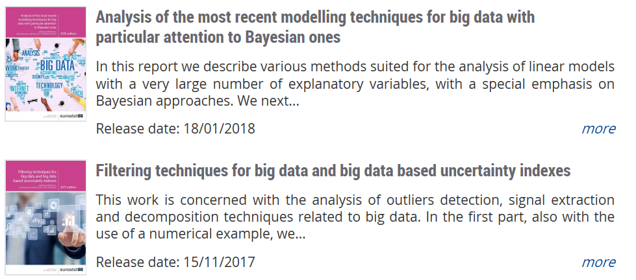
http://ec.europa.eu/eurostat/publications/statistical-working-papers https://github.com/eurostat/econowcast

Slide 23
Some other lessons learned..
Data access is challenging
Quality of sources is an issue
Timeliness gains
Granularity benefits
Validation impacts
Data mesh-ups: new products
New metrics: measure the unmeasured

Slide 24
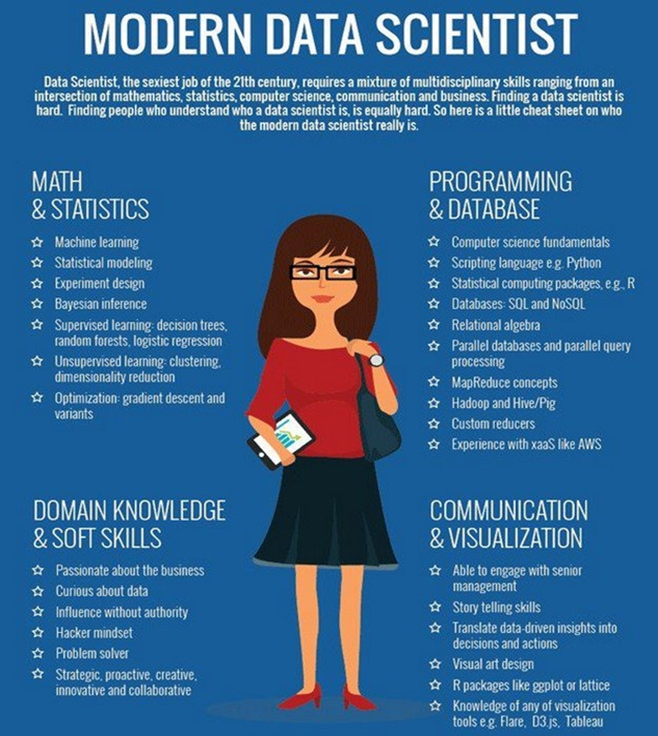
Focus on New Skills for New Methods for New Data

Slide 25
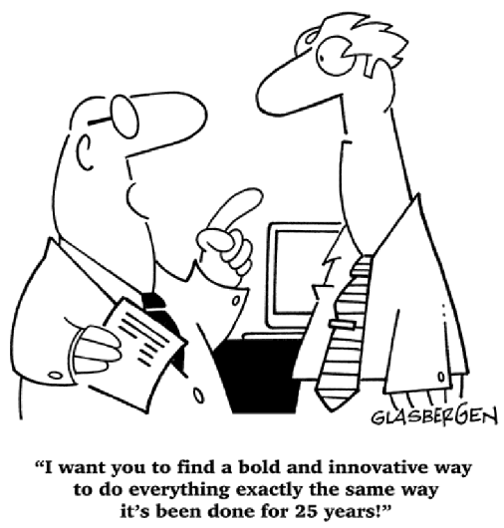
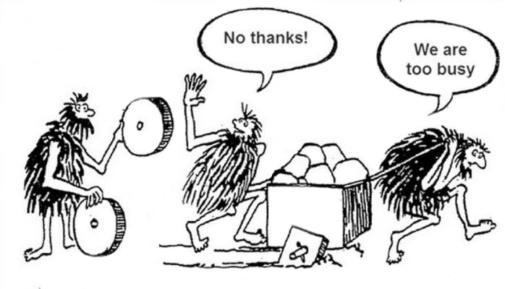
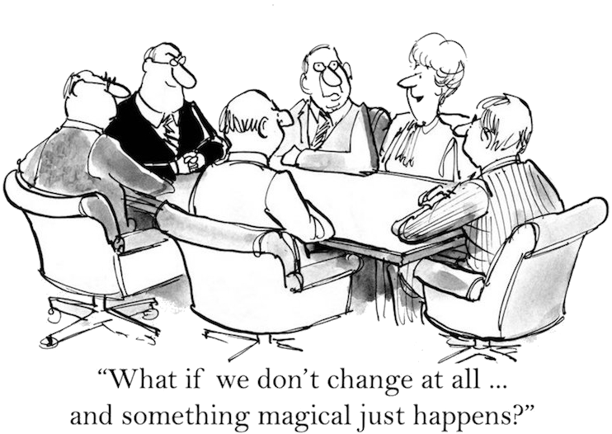
…but it is also about culture & management
program
reuse
version
How are resources (mis)used: Duplication? Redundancy? Cost?
test
document
metadata
share
model
process
automate
?

Slide 26
Open questions for debate
Reversing the approach: starting from the data rather than from the goal?
How can a statistician become a data scientist?
Are Big data more useful for benchmarking purposes or rather to measure new phenomena?
Design based to model based to algorithm based: maybe there is a possible link between SAE and statistical learning?
How to measure data uncertainty?
Dario.Buono@ec.europa.eu
@darbuonoorrespond to those of the corresponding organisations of affiliation

