Slide 1
PISA, 8-10 MAY 2018
WORKSHOP “SMALL AREA METHODS AND LIVING CONDITIONS INDICATORS IN EUROPEAN POVERTY STUDIES IN THE ERA OF DATA DELUGE AND BIG DATA”
FINAL EVENT OF THE JEAN MONNET CHAIR SAMPLEU
“Small scale, big dimensions: sustainable development and innovation at local level”
May, 9th, 2018
Paolo Prosperini – Coordinator, Support Team to Inner Areas Strategy- Cohesion Policy Department – Presidency of Italy’s Council of Ministers

Slide 2
Inner Area: what does it mean?
Inner Areas are those territories characterized by:
a NOT adequate offer of/access to essential services to assure citizen’s rights;
being rich in natural assets (water resources, agricultural systems, forests, natural landscapes) and cultural resources (archaeological settlements, abbeys, small museums, craft centres);
low population density;
often: high seismic risk.
In Italy inner areas cover almost 60% of the whole national territory embracing about 23% of its total population and more than 4,000 municipalities

Slide 3
Methodology to identify Inner Areas
‘Service Centres’ have been defined as those municipalities that offer:
an exhaustive range of secondary schools;
at least a 1st level DEA (highly specialised) hospital;
at least a ‘Silver-type’ railway station (RFI).
NO DEMOGRAPHIC CRITERIA HAVE BEEN APPLIED
Areas have been mapped according to the distance (travel time) from these ‘Service Centres’ as:
‘Belt’ areas – up to 20 minutes;
‘Intermediate’ areas – from 20 to 40 minutes;
‘Remote’ areas – from 40 to 75 minutes;
‘Ultra–remote’ areas – over 75 minutes.
Inner Areas

Slide 4
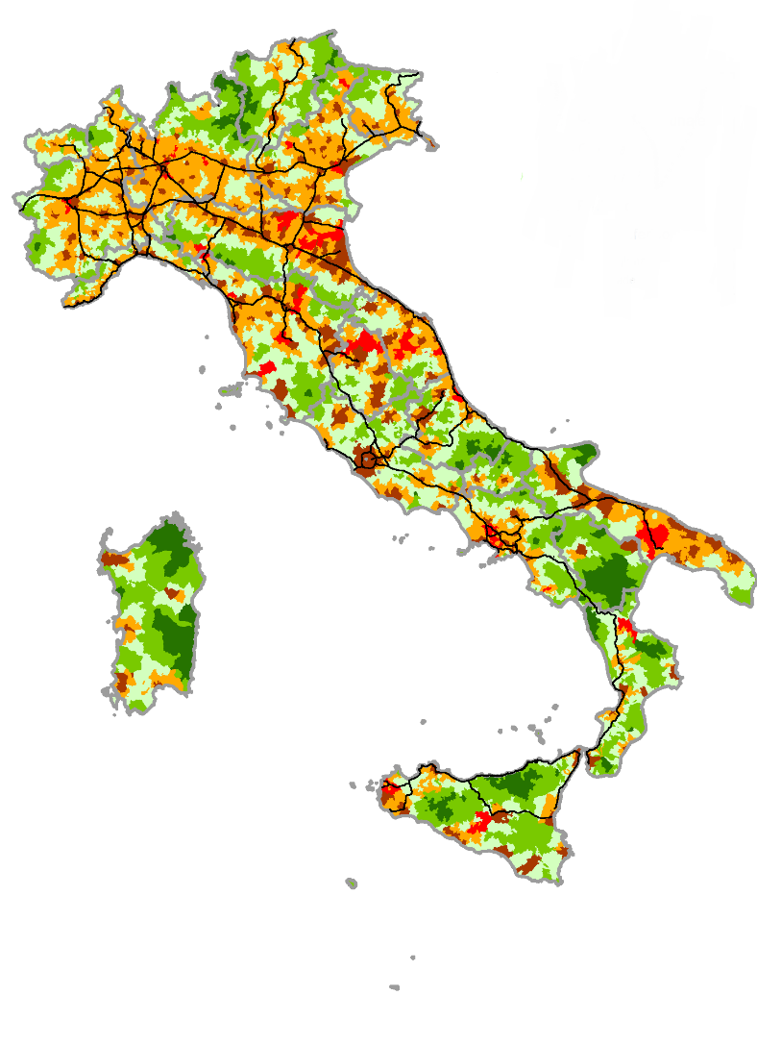
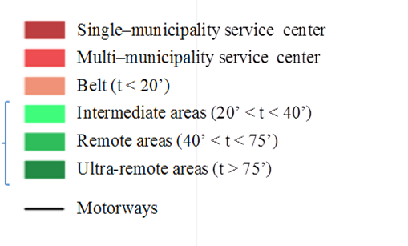
Italy’s Inner Areas
Classification of Municipalities
N.
%
Average
Population
%
KM
2
%
Altitude
Single-Municipality Service Centre
217
2.7
148
20,993,647
35.3
28,987
9.6
Multi-Municipality Service Centre
123
1.5
195
,
3,008,676
5.1
8,736
2.9
Belt areas
3,571
44.1
219
22,150,877
37.3
84,235
27.9
Intermediate areas
2,371
29.3
399
,
8,773,390
14.8
88,461
29.3
Remote area
,
1,520
18.8
601
3,869,379
6.5
72,541
24.0
Ultra-remote areas
290
3.6
666
637,765
1.1
19,113
6.3
Total
8,092
100
358
59,433,734
100
302,073
100.0
Source:
CTAI elaboration Istat - Census 2011
Inner Areas
Source: UVAL-UVER-ISTAT elaboration on data from the Ministry of Health, Ministry of Education and RFI (Italian Railway Network)

Slide 5
Why a National Strategy for Inner Areas?
Territorial Cohesion Objective
To give true content to the EU Cohesion Policy Territorial Objective;
To overcome the rural- urban dichotomy;
To empower territories and people to restore growth and well-being over marginalised areas, recognising their diversity;
To recover not enhanced natural and cultural assets, reducing territories’ depopulation and consequent abandonment costs.
Ultimate Goal: Reinforce Inner Areas demographic structure
Territorial Cohesion
National Government
Department for Development Policy
Local territories
Inner Areas
EAFRD, ERDF, ESF
Stability Law
Multilateral coordination and technical support/ Technical Committee
Project planning
Regions
Vertical integration
Local development

Slide 6
Inner Areas’ Selection Criteria
The Open Inner Areas method: over 100 indicators and filed work to detect:
Territories with people living mainly in Inner Areas;
Inner Areas losing populations;
Inner Areas with consistent elderly characteristics;
Inner Areas with good project implementation capacities;
Inner Areas with strong local leadership and municipalities’ capacity to work in association.

Slide 7
Open Method & Criteria for Area Selection
Two-step assessment process:
Desk analysis (Inner Areas Open Kit)
Each pre-selected area is thoroughly analysed with respect to a series of demographic and socio-economic indicators (116):
e.g. Population losses and demographic structure, Utilized Agricultural Area (UAA) trends, deforestation, hydrological risk, entrepreneurship, tourism and cultural heritage, quality of education, mobility and healthcare services, Digital Divide
Field analysis (National Committee’s visits to pre-selected areas)
A number of focus groups are organised at local level aiming at “meeting territories” – e.g. local authorities, mayors, public officers in charge of services delivery, school directors, teachers, students, hospital managers and physicians ….

Slide 8
Open Kit extract
 | A. General indicators | BASSO SANGRO | VALFINO VESTINA | VALLE ROVETO | VAL SUBEQUANA | ALTO ATERNO | ABRUZZO Inner Areas | ITALY Inner Areas | ABRUZZO | ITALY
a.1 | Municipalities | 33 | 19 | 12 | 24 | 15 | 230 | 4185 | 305 | 8092
a.4 | Resident population at 2011 | 22,568 | 26,680 | 24,529 | 9,358 | 35,568 | 484,35 | 13,328,750 | 1,307,309 | 59,433,744
a.7 | % of population inner areas | 100.0 | 100.0 | 82.4 | 100.0 | 42.7 | 100.0 | 100.0 | 37.0 | 22.4
b.3 | % population aged 65 and over at 2011 | 32.0 | 26.3 | 23.8 | 32.5 | 24.5 | 23.4 | 21.2 | 21.7 | 20.8
b.5 | Change in total population between 1971 and 2011 | -43.8 | -28.4 | -13.6 | -46.5 | -24.2 | -4.0 | 4.6 | 12.1 | 9.8
b.6 | Change in total population between 2001 and 2011 | -13.7 | -6.7 | -5.2 | -10.5 | -2.1 | -0.5 | 2.3 | 3.6 | 4.3

Slide 9
Open Kit extract
 | F. Health (2014) | BASSO SANGRO | VALFINO VESTINA | VALLE ROVETO | VAL SUBEQUANA | ALTO ATERNO | ABRUZZO Inner Areas | ITALY Inner Areas | ABRUZZO | ITALY
f.1 | Specialistica ambulatoriale - Prestazioni erogate x 1000 residenti | 1,388 | 46 | 3,000 | 79 | 1,020 | 2,439 | 2,430 | 4,194 | 4,223
f.2 | Tasso di ospedalizzazione (LEA=170,0) | 136.6 | 160.1 | 160.9 | 145.7 | 153.1 | 153.0 | 145.9 | 153.7 | 170.0
f.3 | Tasso di ospedalizzazione della popolazione ultra 75enne | 309.8 | 379.0 | 366.4 | 326.9 | 323.4 | 356.3 | 348.6 | 372.8 | 336.9
f.4 | Rate of avoidable hospitalization (LEA=570,0) | 789.3 | 758.2 | 759.0 | 794.4 | 590.4 | 712.6 | 617.3 | 574.9 | 570.0
f.5 | Percentuale anziani >=65 anni residenti trattati in Assistenza Domiciliare Integrata (ADI) | 1.2 | 3.4 | 5.0 | 7.0 | 4.9 | 3.1 | 4.5 | 3.4 | 4.2
f.6 | Percentuale di parti in cui la prima visita è effettuata a partire dalla dodicesima settimana di gestazione | 3.4 | 3.6 | 3.9 | 8.1 | 9.5 | 4.8 | 9.9 | 6.1 | 9.3
f.7 | Time (in minutes ) between the start of the telephone call to the monitoring station and the arrival of the first rescue vehicle on the spot. ( - Target Eemrgency ). | 45 | 38 | 28 | 43 | 34 | 26 | 23 | 23 | 16

Slide 10
Open Kit extract
 | H. Scuola (2014-2015) | BASSO SANGRO | VALFINO VESTINA | VALLE ROVETO | VAL SUBEQUANA | ALTO ATERNO | ABRUZZO Inner Areas | ITALY Inner Areas | ABRUZZO | ITALY
h.1 | N. medio scuole sede di erogazione del servizio per istituto scolastico | 12.3 | 8.0 | 9.3 | 14.0 | 8.4 | 6.3 | 5.9 | 5.6 | 4.7
h.2 | Numero di scuole | 15 | 16 | 10 | 8 | 19 | 211 | 5,113 | 434 | 16,929
h.3 | % comuni dotati di scuola primaria | 45.5 | 73.7 | 75.0 | 33.3 | 80.0 | 71.3 | 78.3 | 77.0 | 82.7
h.4 | N. medio alunni per scuola | 40.8 | 56.8 | 80.2 | 28.5 | 61.7 | 89.6 | 113.4 | 131.4 | 165.0
h.5 | % alunni con cittadinanza non italiana | 5.2 | 6.4 | 13.7 | 21.9 | 12.5 | 7.7 | 8.3 | 7.7 | 10.3
h.6 | Rapporto alunni disabili-docenti di sostegno | 2.0 | 1.8 | 1.9 | 1.6 | 1.7 | 2.1 | 1.7 | 2.0 | 1.8
h.7 | % alunni residenti nello stesso comune della scuola | 76.5 | 85.0 | 83.3 | 53.9 | 90.1 | 86.6 | 89.4 | 86.7 | 88.7
h.8 | Tasso di mobilità dei docenti | 3.5 | 8.6 | 10.8 | 25.9 | 5.8 | 7.7 | 6.3 | 6.4 | 5.8
h.9 | % classi con numero di alunni fino a 15 | 81.3 | 59.7 | 64.9 | 90.5 | 61.4 | 43.3 | 35.3 | 28.2 | 19.4
h.10 | % pluriclassi su totale classi | 37.5 | 24.2 | 3.5 | 57.1 | 8.8 | 10.2 | 5.0 | 4.1 | 1.7
h.11 | % classi a tempo pieno | 18.8 | 6.5 | 8.8 | 14.3 | 0.0 | 11.8 | 24.3 | 13.9 | 32.2
h.12 | % docenti a tempo determinato | 14.4 | 13.4 | 11.5 | 13.8 | 15.0 | 11.2 | 10.7 | 9.0 | 11.5
h.13 | Test Invalsi: punteggio medio ( e dev. standard) del test di Italiano - Classe V primaria | 53.8 (16,4) | 53.0 (16.2) | 55.2 (15.8) | 54.8 (15.8) | 54.8 (15.8) | 54.2 (16.0) | 55.1 (16.2) | 56.5 (15.2) | 56.6 (16.0)
h.14 | Test Invalsi: punteggio medio ( e dev. standard) del test di matematica - Classe V primaria | 50.6 (17.0) | 53.4 (17.2) | 52.8 (17.0) | 53.2 (16.6) | 52.2 (16.0) | 52.5 (16.8) | 53.6 (17.6) | 53.8 (16.8) | 54.6 (17.8)

Slide 11
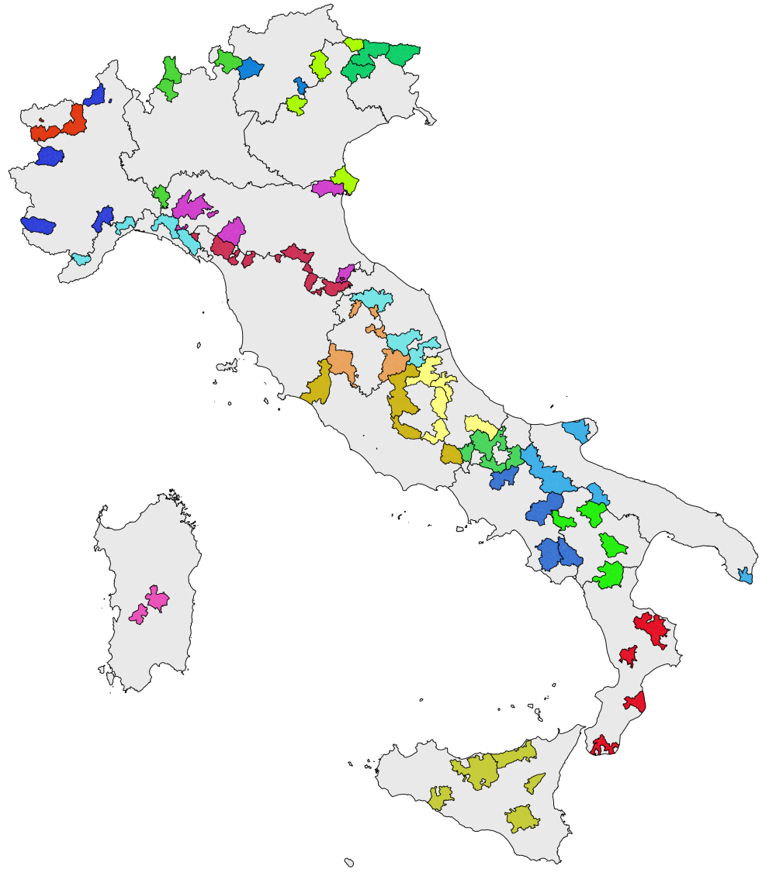
Selected project areas
At the current stage, selected areas within the Strategy are:
72 project areas with about 2mln. total residents and 1,077 municipalities;
on average: 15 municipalities and 29,000 residents per project area;
about 3% of Italian population and 16.7% of Italian territory;
55% of those 2 mln. live in remote and ultra-remote areas;
4.4% population drop among selected areas between 2001 and 2011, and 2.3% between 2011 and 2016.
*Source: Inner Area Strategy

Slide 12
Inner Areas National Strategy Method
Quantitative data and qualitative information are used to identify and select weakest Inner Areas
Each selected area define its local development strategy
A local development strategy is an integrated path aimed at development and growth
It is based on local essential services improvements and local development projects support
The Technical Committee along with Regions analyse Inner Areas through a desk-analysis and a field-analysis process

Slide 13
How do we monitor results?
– an example–
Actions:
Increase transport organisation and efficiency that influence inhabitants’ access to healthcare services
Promote social inclusion, fight against poverty and all forms of discrimination
Increase/Enhancement of care services and healthcare and social service infrastructure.
Result Indicators to measure healthcare improvements:
Reduce the time (in minutes) between the start of the emergency telephone call made and first aid vehicle’s arrival at the site
Percentage increase in population aged 65 and over treated via Integrated Home Care (ADI) services
Increase specialist outpatient services provided per 1,000 residents

Slide 14
Panel open questions
Potential and effective use of data at local scale for policy address and / or evaluation
What difficulties have been encountered and whether innovative solutions and strategies have been proposed
What information needs I consider to be the most urgent to comply our meet for your work, what data at a local level I miss most

Slide 15
“..If you torture a data long enough, it will confess anything”
Ronald Harry Coase
THANK YOU!

